Slide 1



Inspire
The Campus Connect Faculty Partnership Model
11
Campus Connect Faculty Excellence Awards 2015 Track: Distinguished Facilitator

Slide 2
- Prof. Jigar M. Pandya
- Prof. Hariom A. Pandya
Dharmsinh Desai University, Nadiad - Gujarat.
THINK : Teaching (that) Helps Improvise
Native Knowledge

Slide 3
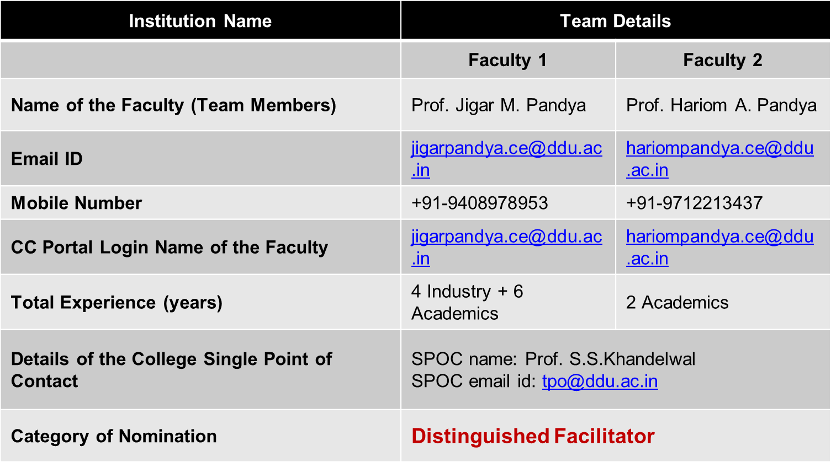
Personal Information

Slide 4
(THINK) Teaching(that) Helps Improvise Native Knowledge
(Native : inherent, natural, or innate: a native strength)
CORE IDEA: “Geniuses are not made but they can be developed.”
Teaching Learning Practices:
With the above core idea, we at DDU Computer Engineering Department, plan to bring inherent strength of students to the real practice in the field of computer engineering.
Students, from the first year of B.Tech Computer Engineering, are found a lot enthusiastic at our institute. They need continuous direction to move forward in the field and follow learning practices that improvise their native knowledge.
We, as a team at DDU, tried various teaching practices and use of technology to quench the thirst.
Leveraging Technology relevant to courses :
Moodle (Learning Management System), IITB Spoken Tutorials, Gmail Plus, CareerCup

Slide 5
Teaching(that) Helps Improvise Native Knowledge
“reThink Week # [1..12]”
Lab practical list: core and plus topics
Projects and program exercises
Learning from exam
Promote certifications to build students' effective resume
Do and don'ts in computer programming
Admiring student efforts via sharing their work with others
Field related real examples and knowledge sharing
Highlighting Computer friends, productivity notes to speed up development
Different job titles and related tasks
Moodle supported online quiz
Email Communication using gmail batch group

Slide 6
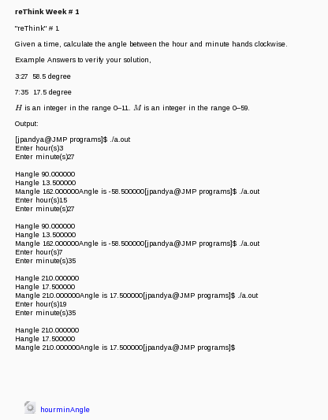
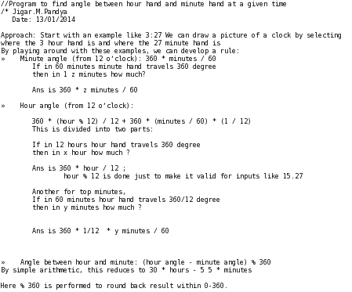
To brain storm real time interview questions and improve problem solving skills
"reThink" # 1Given a time, calculate the angle between the hour and minute hands clockwise.

Slide 7
Teaching(that) Helps Improvise Native Knowledge
“reThink Week # [1..12]”
Lab practical list: core and plus topics
Projects and program exercises
Learning from exam
Promote certifications to build students' effective resume
Do and don'ts in computer programming
Admiring student efforts via sharing their work with others
Field related real examples and knowledge sharing
Highlighting Computer friends, productivity notes to speed up development
Different job titles and related tasks
Moodle supported online quiz
Email Communication using gmail batch group

Slide 8
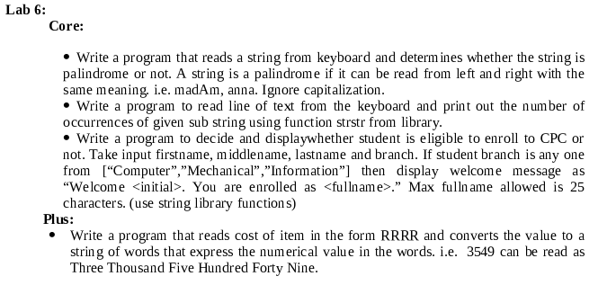
Core and Plus Part in Practical List :
For example, to learn Strings in C,
Core includes all topics but concept related simple programming exercise
Plus includes real time problem to match the topic knowledge. i.e. a bank check computerized amount print

Slide 9
Teaching(that) Helps Improvise Native Knowledge
“reThink Week # [1..12]”
Lab practical list: core and plus topics
Projects and program exercises
Learning from exam
Promote certifications to build students' effective resume
Do and don'ts in computer programming
Admiring student efforts via sharing their work with others
Field related real examples and knowledge sharing
Highlighting Computer friends, productivity notes to speed up development
Different job titles and related tasks
Moodle supported online quiz
Email Communication using gmail batch group

Slide 10
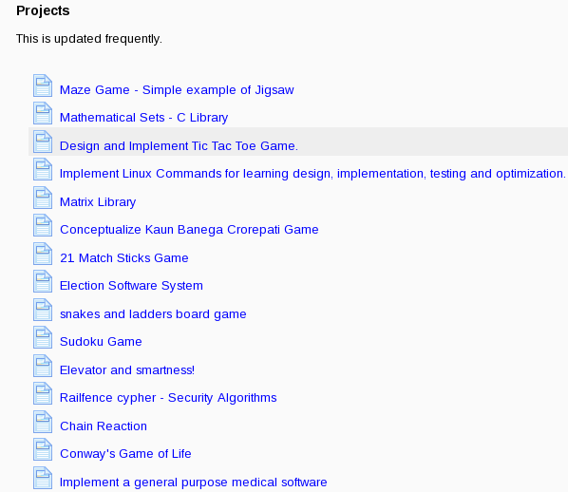
To passionate about programming, in varieties of fields like games, graphics, geography, maths, government, security, etc provide frequently updated list

Slide 11
Teaching(that) Helps Improvise Native Knowledge
“reThink Week # [1..12]”
Lab practical list: core and plus topics
Projects and program exercises
Learning from exam
Promote certifications to build students' effective resume
Do and don'ts in computer programming
Admiring student efforts via sharing their work with others
Field related real examples and knowledge sharing
Highlighting Computer friends, productivity notes to speed up development
Different job titles and related tasks
Moodle supported online quiz
Email Communication using gmail batch group

Slide 12
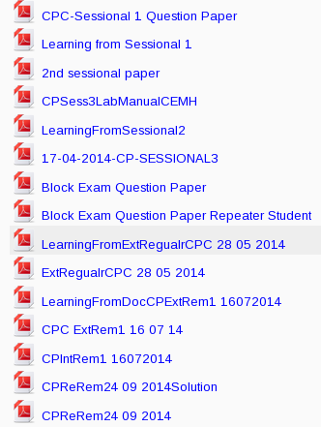
Sharing Soft Copy of question papers with “Context based Solution -> Document for learning from exam”
Weak students get chance to look at actual simplest solution
Intermediate student catches their mistakes
Expert student get idea of solutions by other student and faculty members

Slide 13
Teaching(that) Helps Improvise Native Knowledge
“reThink Week # [1..12]”
Lab practical list: core and plus topics
Projects and program exercises
Learning from exam
Promote certifications to build students' effective resume
Do and don'ts in computer programming
Admiring student efforts via sharing their work with others
Field related real examples and knowledge sharing
Highlighting Computer friends, productivity notes to speed up development
Different job titles and related tasks
Moodle supported online quiz
Email Communication using gmail batch group

Slide 14
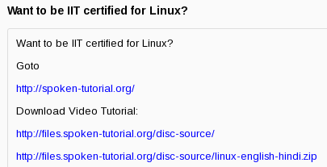
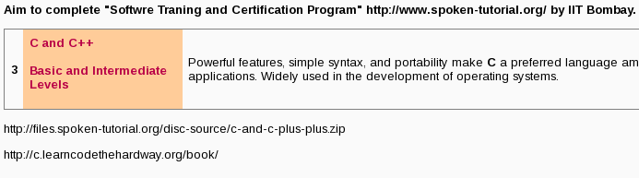
A vital step towards setting the goal for student
From the beginning of course, student are encouraged to prepare for certificate by IITs.
More than 100 out of 120 earned Linux OS and Programming certificates 2013-14 B.Tech CE Year1.

Slide 15
Teaching(that) Helps Improvise Native Knowledge
“reThink Week # [1..12]”
Lab practical list: core and plus topics
Projects and program exercises
Learning from exam
Promote certifications to build students' effective resume
Do and don'ts in computer programming
Admiring student efforts via sharing their work with others
Field related real examples and knowledge sharing
Highlighting Computer friends, productivity notes to speed up development
Different job titles and related tasks
Moodle supported online quiz
Email Communication using gmail batch group

Slide 16
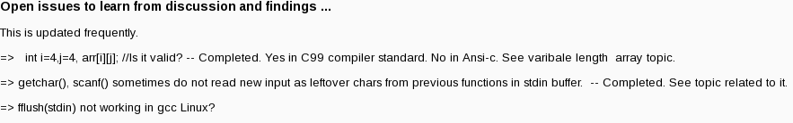
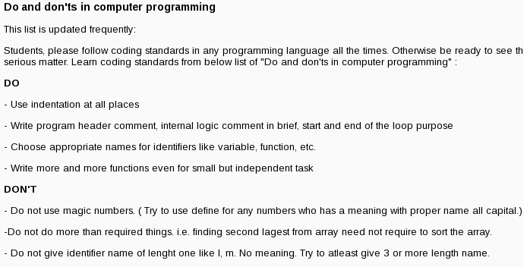
Many times students understand and follow better, if things are listed clearly with bullets like sticky note

Slide 17
Teaching(that) Helps Improvise Native Knowledge
“reThink Week # [1..12]”
Lab practical list: core and plus topics
Projects and program exercises
Learning from exam
Promote certifications to build students' effective resume
Do and don'ts in computer programming
Admiring student efforts via sharing their work with others
Field related real examples and knowledge sharing
Highlighting Computer friends, productivity notes to speed up development
Different job titles and related tasks
Moodle supported online quiz
Email Communication using gmail batch group

Slide 18
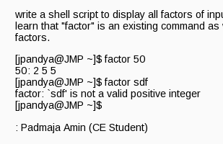
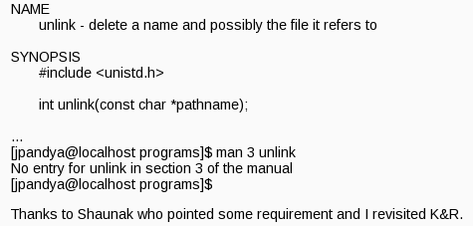

Slide 19
Teaching(that) Helps Improvise Native Knowledge
“reThink Week # [1..12]”
Lab practical list: core and plus topics
Projects and program exercises
Learning from exam
Promote certifications to build students' effective resume
Do and don'ts in computer programming
Admiring student efforts via sharing their work with others
Field related real examples and knowledge sharing
Highlighting Computer friends, productivity notes to speed up development
Different job titles and related tasks
Moodle supported online quiz
Email Communication using gmail batch group

Slide 20
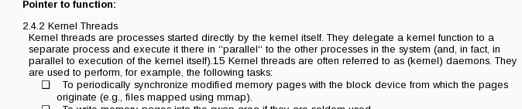

Student enjoy real fundamentals and used in real operating systems. Here, to explain pointer to function concept, real time linux kernel threads and callback function example is taken.
Setting a model to show importance of knowledge sharing as well as giving credits

Slide 21
Teaching(that) Helps Improvise Native Knowledge
“reThink Week # [1..12]”
Lab practical list: core and plus topics
Projects and program exercises
Learning from exam
Promote certifications to build students' effective resume
Do and don'ts in computer programming
Admiring student efforts via sharing their work with others
Field related real examples and knowledge sharing
Highlighting Computer friends, productivity notes to speed up development
Different job titles and related tasks
Moodle supported online quiz
Email Communication using gmail batch group

Slide 22
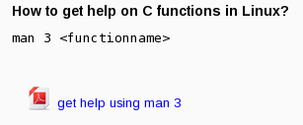
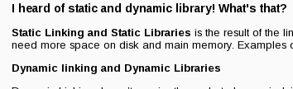


Highlighting Computer friends i.e. logs, manual pages, etc.

Slide 23
Teaching(that) Helps Improvise Native Knowledge
“reThink Week # [1..12]”
Lab practical list: core and plus topics
Projects and program exercises
Learning from exam
Promote certifications to build students' effective resume
Do and don'ts in computer programming
Admiring student efforts via sharing their work with others
Field related real examples and knowledge sharing
Highlighting Computer friends, productivity notes to speed up development
Different job titles and related tasks
Moodle supported online quiz
Email Communication using gmail batch group

Slide 24
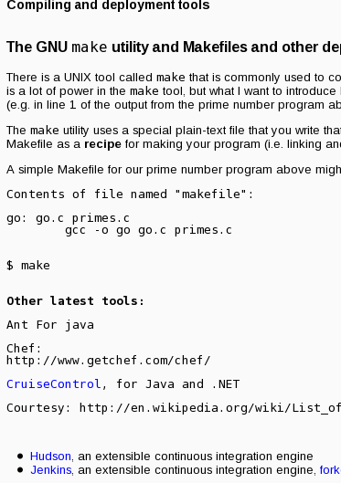
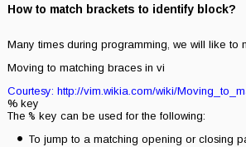
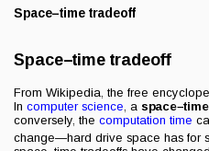
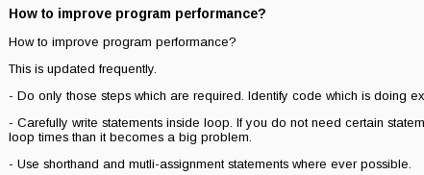
Differnt job titles and related tasks

Slide 25
Teaching(that) Helps Improvise Native Knowledge
“reThink Week # [1..12]”
Lab practical list: core and plus topics
Projects and program exercises
Learning from exam
Promote certifications to build students' effective resume
Do and don'ts in computer programming
Admiring student efforts via sharing their work with others
Field related real examples and knowledge sharing
Highlighting Computer friends, productivity notes to speed up development
Different job titles and related tasks
Moodle supported online quiz
Email Communication using gmail batch group

Slide 26
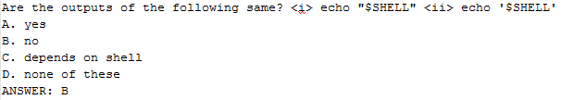
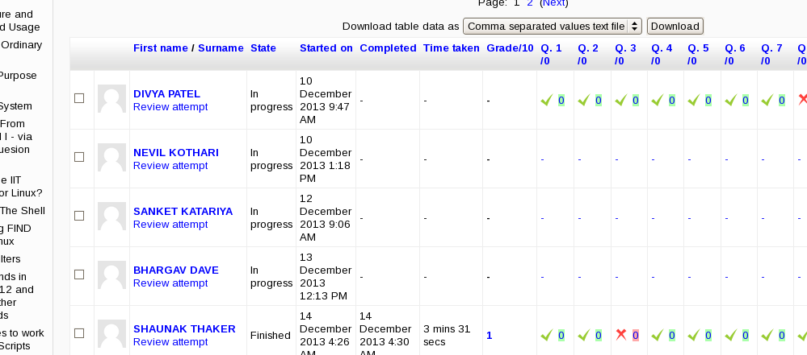
Created AIKEN format based text file and imported into moodle for online quiz and practice of programming questions and review correct answers.

Slide 27
Teaching(that) Helps Improvise Native Knowledge
“reThink Week # [1..12]”
Lab practical list: core and plus topics
Projects and program exercises
Learning from exam
Promote certifications to build students' effective resume
Do and don'ts in computer programming
Admiring student efforts via sharing their work with others
Field related real examples and knowledge sharing
Highlighting Computer friends, productivity notes to speed up development
Different job titles and related tasks
Moodle supported online quiz
Email Communication using gmail batch group

Slide 28
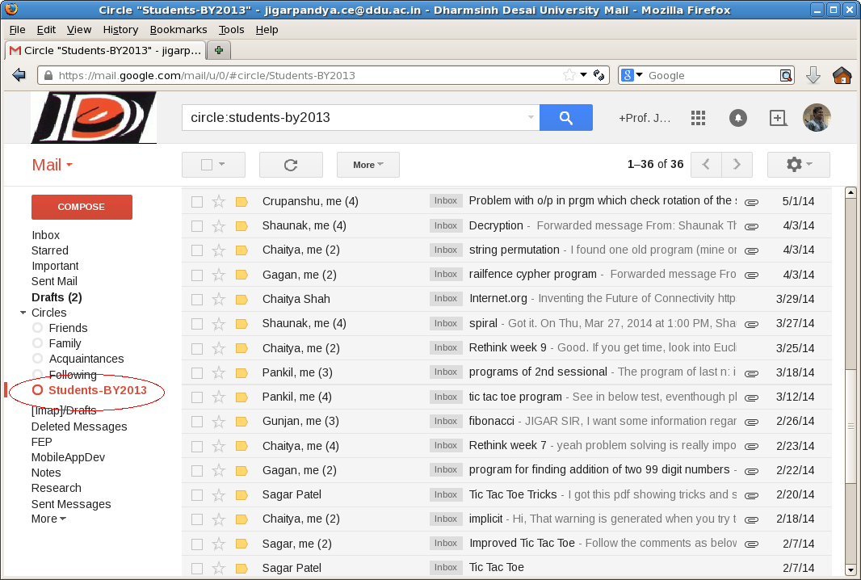
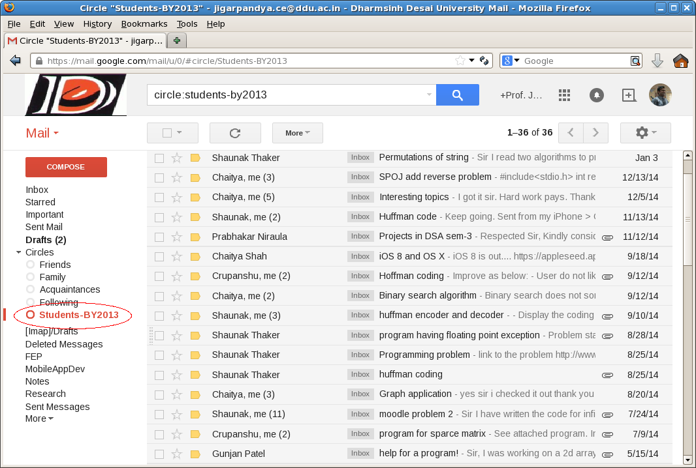

Slide 29
Conclusion
Overall students’ participation in the subject was noteworthy during this course of activities.
Students admitted improvement in native knowledge
Students found performing better in the later semester courses
More practical oriented and are now able to relate theory topics to real world or practically in the computer engineering field at least.
Use of moodle, IITB spoken tutorial, email communication, etc are now generating knowledge base.
Faculties are putting efforts into adding new fruitful content to the course instead wasting time in maintaining same old content every year.
With the innovative teaching and learning practices, below statement is not completely true anymore.
“Teacher having five years of experience in a subject means having 1 year of experience five times.”

Slide 30
References
http://www.ddu.ac.in/
http://www.egov.ddit.ac.in/moodle/
https://moodle.org/
https://docs.moodle.org/24/en/Aiken_format
http://spoken-tutorial.org/
https://plus.google.com/
http://www.careercup.com/
http://www.codechef.com/
https://www.google-melange.com/gsoc/homepage/google/gsoc2015
https://campusconnect.infosys.com

Slide 31
THANK YOU
www.infosys.com
© 2014 Infosys Limited, Bangalore, India. All Rights Reserved. Infosys believes the information in this document is accurate as of its publication date; such information is subject to change without notice. Infosys acknowledges the proprietary rights of other companies to the trademarks, product names and such other intellectual property rights mentioned in this document. Except as expressly permitted, neither this documentation nor any part of it may be reproduced, stored in a retrieval system, or transmitted in any form or by any means, electronic, mechanical, printing, photocopying, recording or otherwise, without the prior permission of Infosys Limited and/ or any named intellectual property rights holders under this document.
Notes:
3131
To reproduce this slide simply create a new slide, right click and select layout and apply the Notes&Disclaimer layout.

